Slide 1
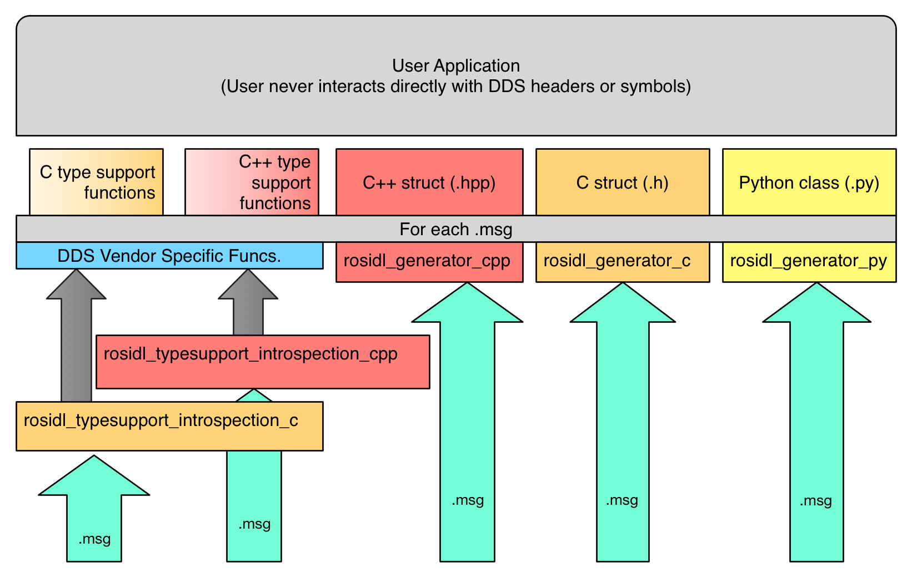
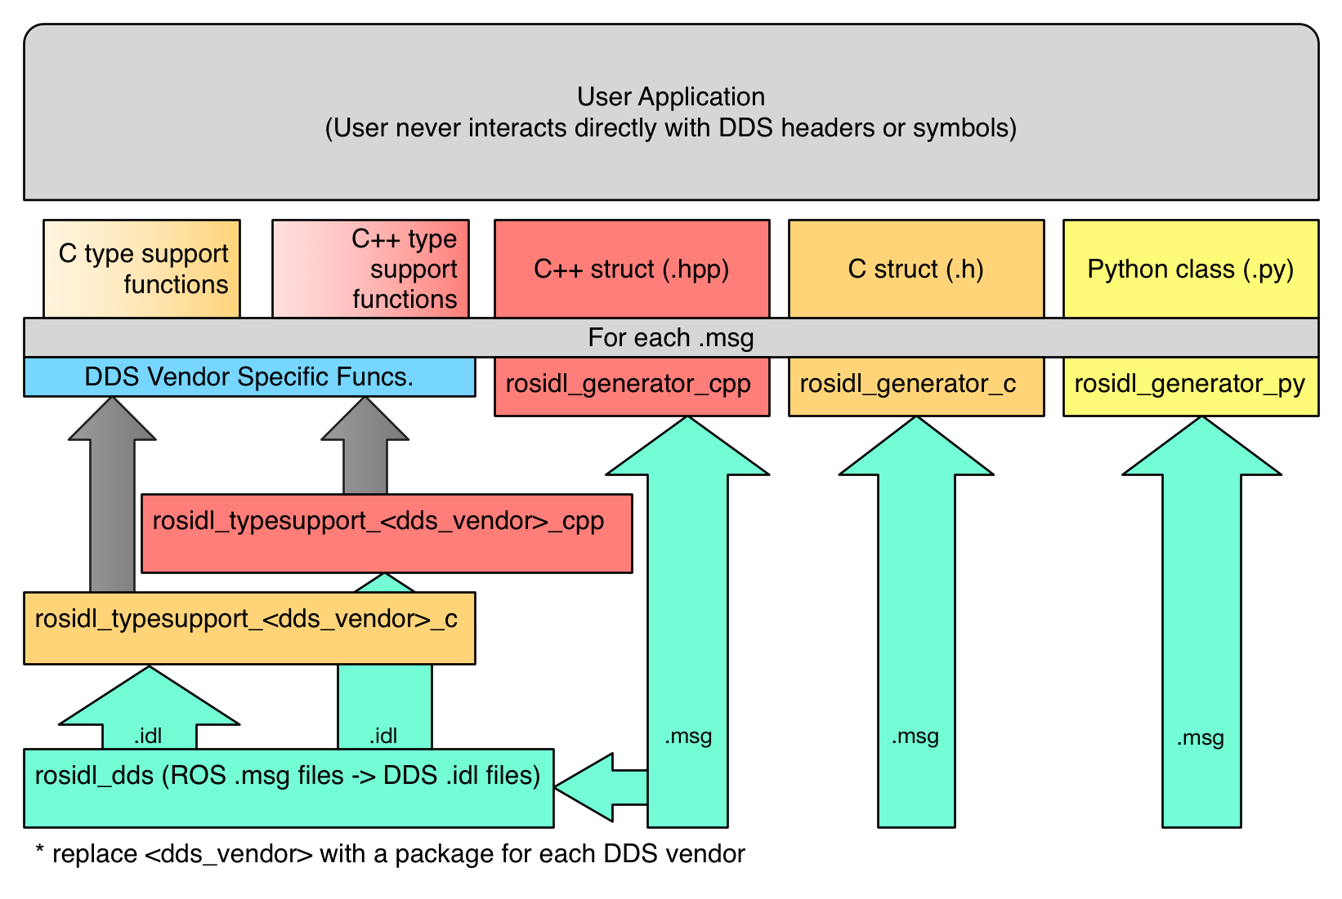
Typeadapter_protobuf
Proto
Proto C++ struct (.hpp)
For each .proto
protobuf_cpp
protobuf_c
rosidl_typesupport_protobuf
.proto
rosidl_adapter_proto
Existing external capabilities
New Implementation

